Slide 1

Analysis of natural disasters and their influences on the United States
Kaiqi Yu

Slide 2
Introduction
The United States experiences a large variety of natural disasters each year: hurricanes, tsunamis, wildfires, earthquakes, etc.
While they claimed countless lives, they also caused other immeasurable losses. In order to understand them better, it is necessary to analyze factors related to them.
This project uses visualization to help describe when and where natural disasters have occurred in the country in recent years, responses of government, and check whether it caused economic and demographic changes

Slide 3
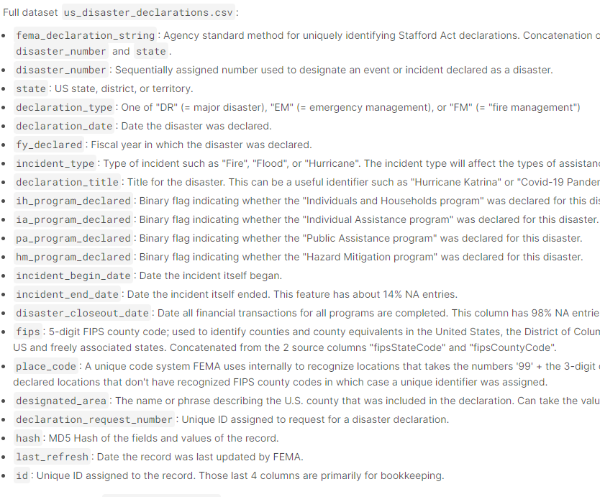
Data
Disaster data was from Kaggle "US Natural Disaster Declarations".
GDP and population data was from data.worldbank.org

Slide 4
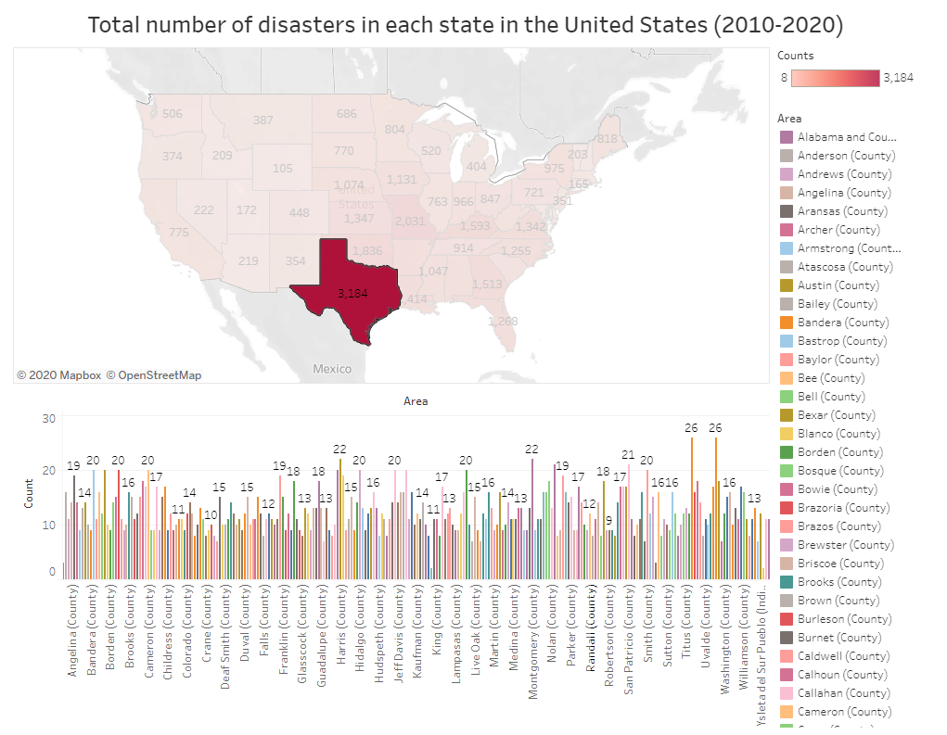
Texas suffers the most disasters.

Slide 5
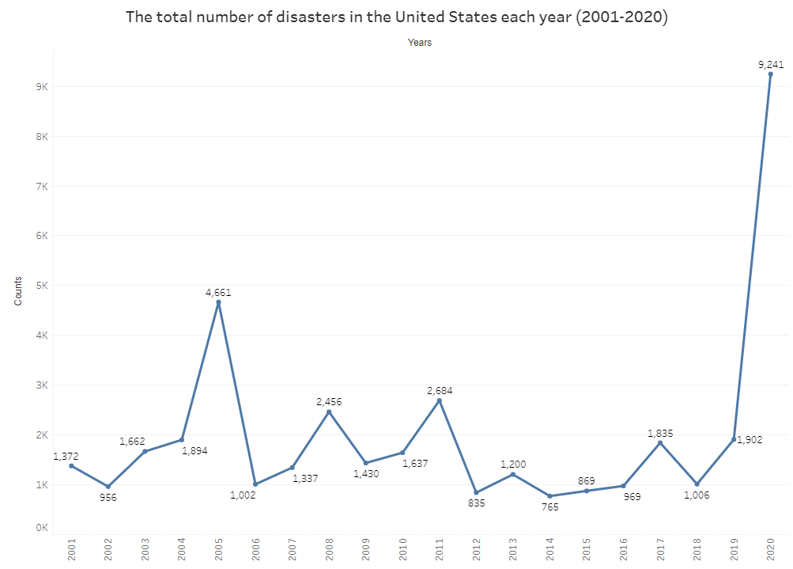
2020 has the largest number of natural disasters, followed by 2005.

Slide 6
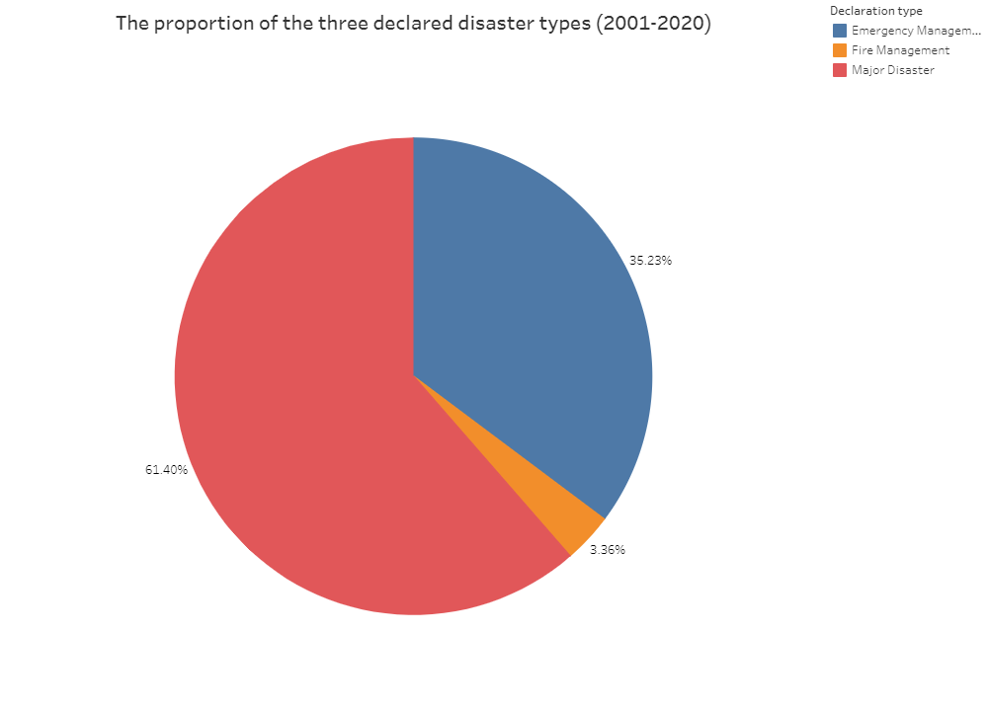
Major disasters account for more than half of the natural disasters declared by the government.

Slide 7
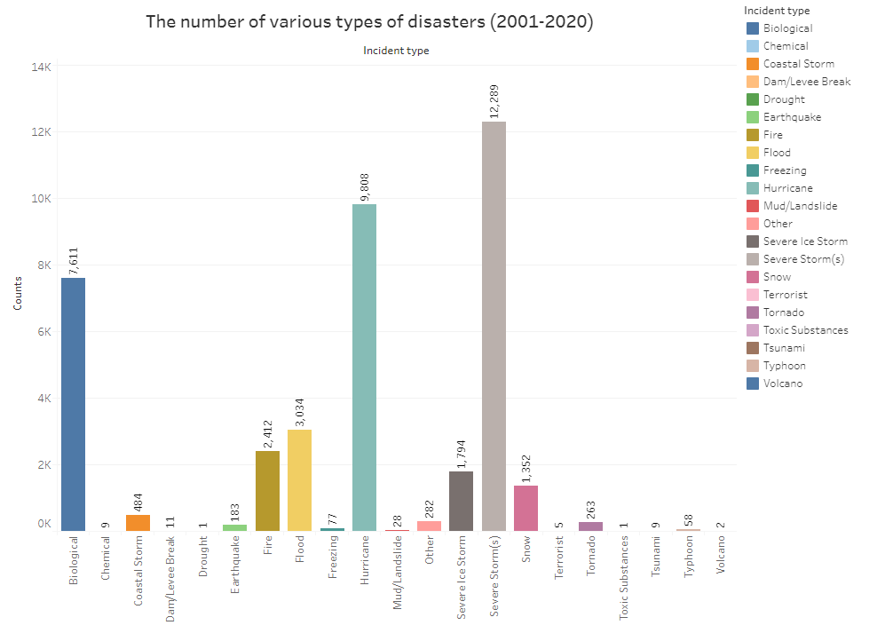
Severe storm is the most common type of disaster, followed by hurricane and biological disasters.

Slide 8
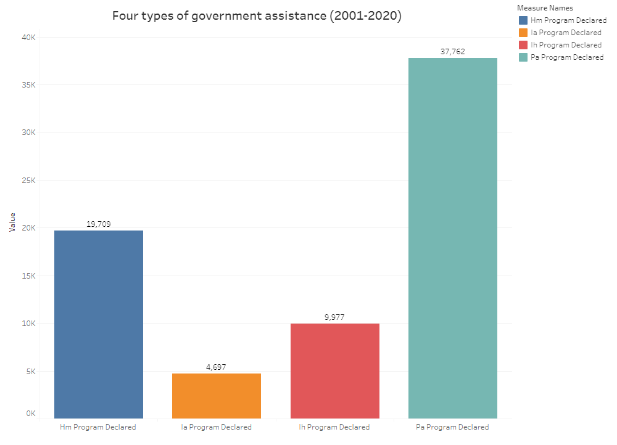
The most common government assistance programs are Public Assistance program and Hazard Mitigation program.

Slide 9
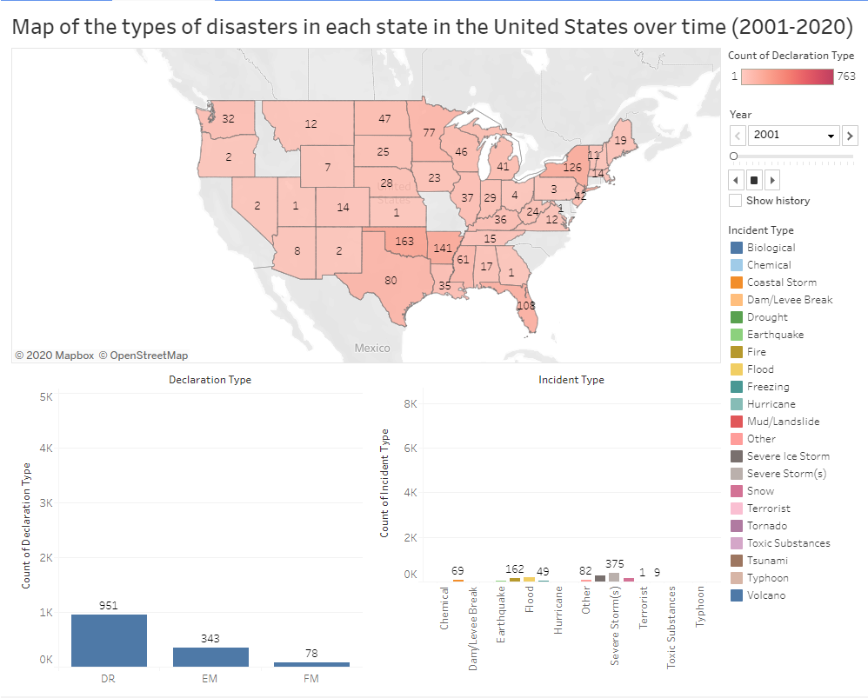
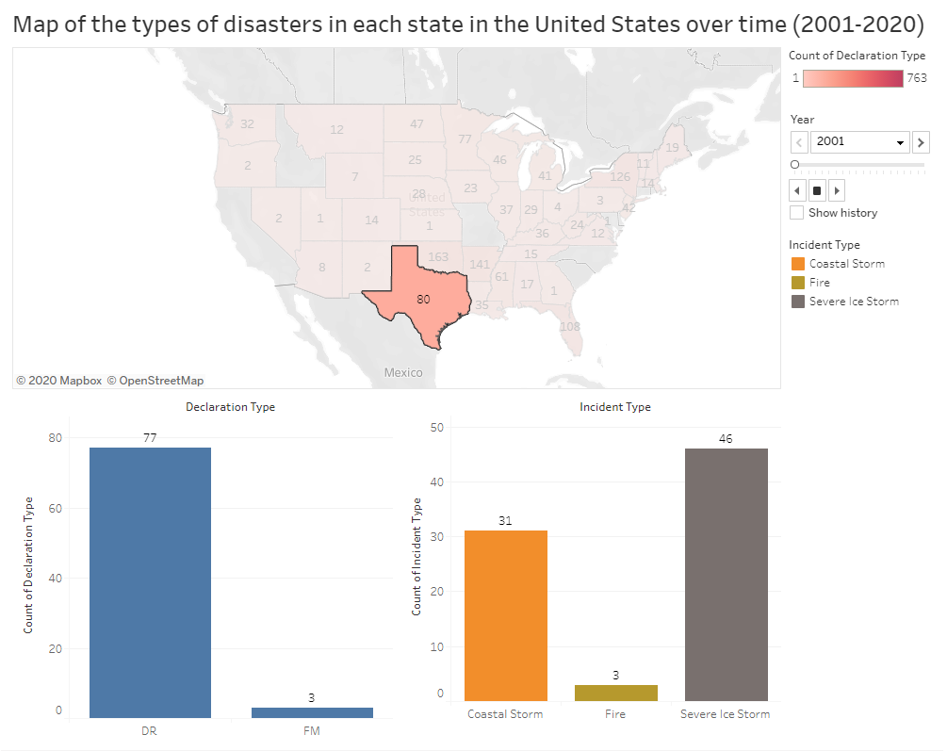

Slide 10
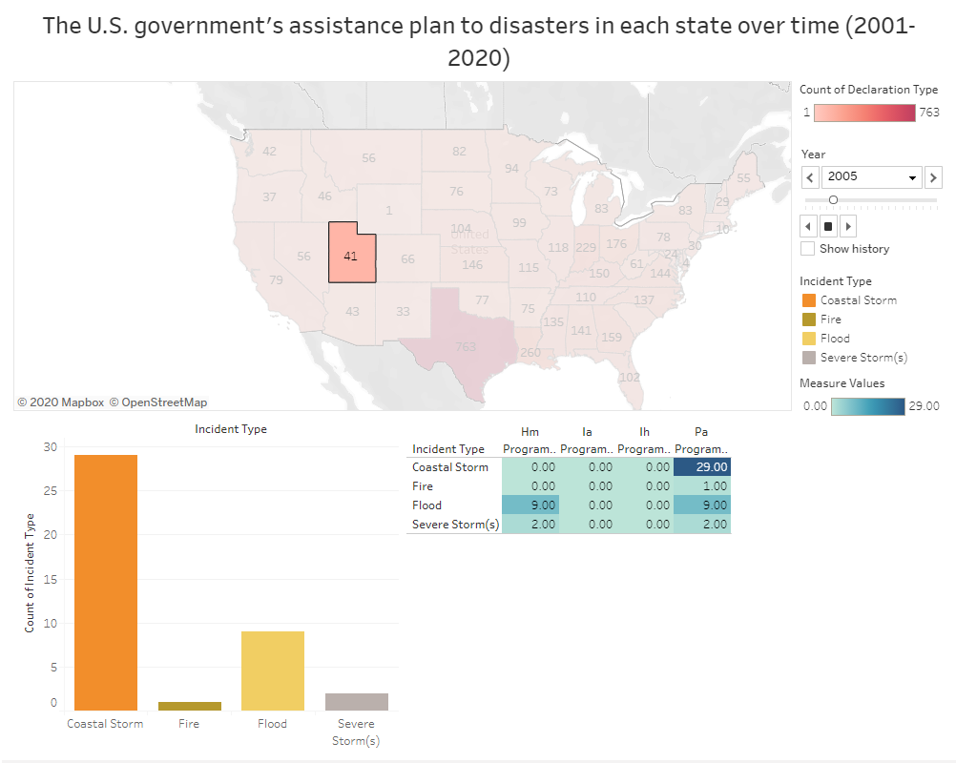
As the most common type of assistance, public assistance programs are launched almost every time the government announces a natural disaster.

Slide 11
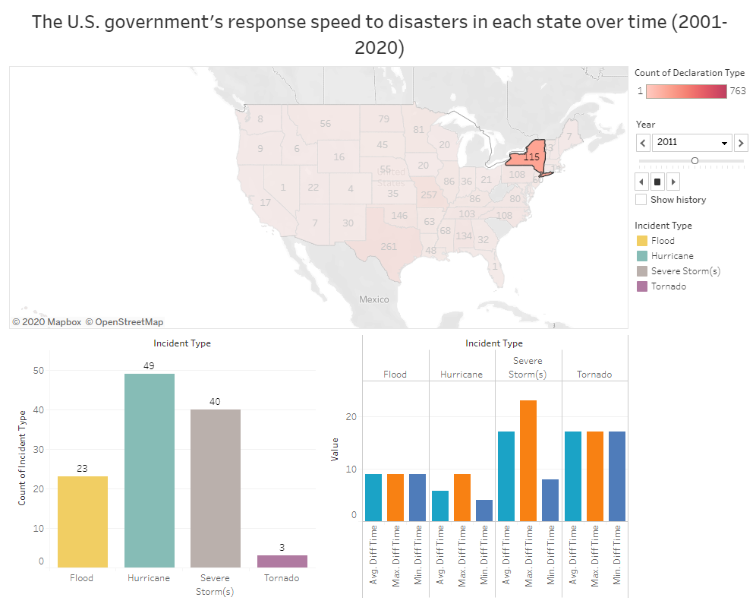
The government’s response time to natural disasters does not exceed 24 hours at most, and the minimum response time is instant.

Slide 12
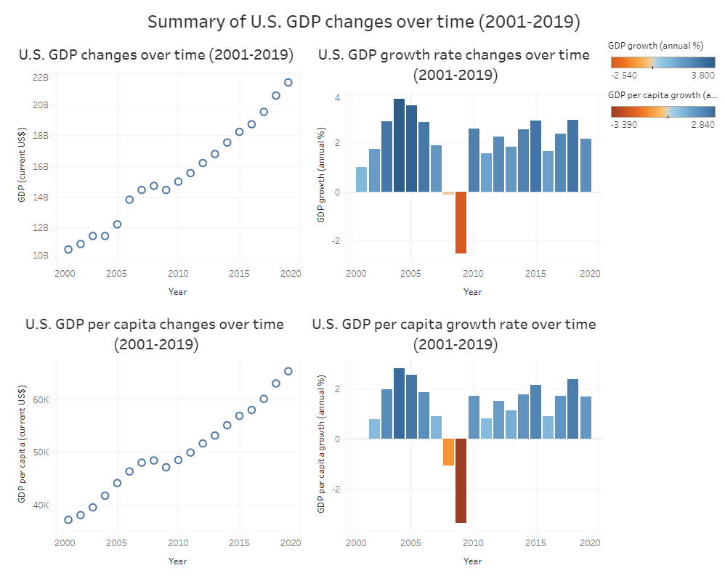

Slide 13
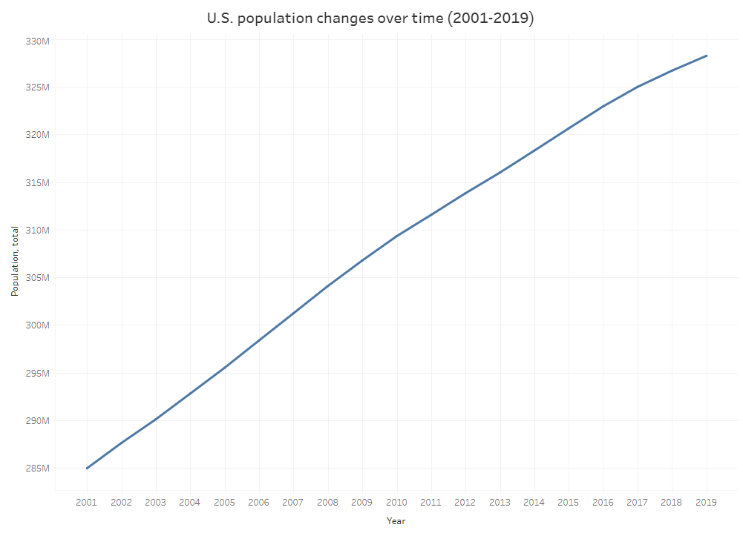
According to the chart, the population and economy have maintained steady growth. It shows that natural disasters may not be the only influencing factor. Besides, the government's immediate response and reasonable assistance programs may reduce the negative impact of natural disasters.

Slide 14

Conclusion
Area data and disaster data are closely related. On the contrary, time data and disaster data are not much related.
The government's response strategy and speed are also affected by the type of the disaster.
Natural disasters may not be the only influencing factor.
The government's immediate response and reasonable assistance programs may reduce the negative impact of natural disasters.

Slide 15

Thank you

